Slide 1
In the world around you, energy is transforming continually between one form and another.
Often, one form of energy changes into more than one form.
Notes:
Instructional Approach(s): The teacher should present the information on the slide.

Slide 2
According to the Law of Conservation of Energy, energy is never created or destroyed, it just changes its form.
Demonstration of the Law of Conservation of Energy: Exploratorium: Science of Baseball – “Baseketball a Physicist Party Trick”
Notes:
Instructional Approach(s): The teacher should present the information on the slide while the students record the important information on their graphic organizer. The teacher should use the link to demonstrate the size of the law of conservation of energy.

Slide 3
Law of Conservation of ENERGY
In the world around you, energy is transforming continually between one form and another.
Often one form of energy changes into more than one form.
According to the Law of Conservation of Matter and Energy, Energy is never created nor destroyed, it just changes its form.
KE + PE (beginning) = KE + PE (end)

Slide 4
Examples of Transforming Thermal (Heat) Energy
When an object is heated to a high temperature, it glows and gives off heat. Therefore, some thermal energy is converted to electromagnetic energy
Energy in the form of thermal (heat) is almost always one of the products of an energy transformation.
A fire or a flame converts thermal energy to electromagnetic energy
For example, when people exercise, when cars run, when a light is turned on, friction on anything moving, heat is produced.
Notes:
Instructional approach: The teacher should present the information on the slide while the students record the important information on their graphic organizer. The teacher may want to ask students to just pick one or two examples to include on their graphic organizer or shorten the examples to fit.

Slide 5
Examples of Transforming Chemical Energy
Inside your body, chemical energy is transformed into mechanical energy (kinetic energy)
Batteries, wood, matches, fireworks, fossil fuels, etc. are forms of chemical energy that are converted into other forms once used or burned
The matter contained in living organisms has chemical energy. When organisms die, this chemical energy is broken down and converted to other chemical compounds. In this process, thermal energy is released.
Notes:
Instructional approach: The teacher should present the information on the slide while the students record the important information on their graphic organizer. The teacher may want to ask students to just pick one or two examples to include on their graphic organizer or shorten the examples to fit.

Slide 6
Examples of Transforming Electromagnetic (Light /Radiant) Energy
Plants use light (radiant) energy to make chemical energy. [remember Photosynthesis]
The chemical energy in food is then changed into another kind of chemical energy that your body can use. [remember cellular respiration]
Your body then uses that energy to give you mechanical energy [kinetic and potential energy]
Also, the electromagnetic (radiant) energy converted into chemical energy in say a tree can then be changed into thermal energy when you burn the tree’s wood.
Notes:
Instructional approach: The teacher should present the information on the slide while the students record the important information on their graphic organizer. The teacher may want to ask students to just pick one or two examples to include on their graphic organizer or shorten the examples to fit.

Slide 7


Examples of Transforming Electrical Energy
Every time you plug something into a wall outlet, you are using electrical energy and that electrical energy is transformed into other forms of energy
Blender:
electrical energy ⇨ mechanical energy
and thermal
Hairdryer:
electrical energy ⇨ mechanical energy, thermal energy
Alarm Clock: electrical energy ⇨ electromagnetic energy and mechanical (sound) energy
Notes:
Instructional approach: The teacher should present the information on the slide while the students record the important information on their graphic organizer. The teacher may want to ask students to just pick one or two examples to include on their graphic organizer or shorten the examples to fit. Another example: Electrical energy changes into thermal energy when a wire carrying an electric current gets hot.

Slide 8


Let’s examine the Energy Transformation in riding a bike.
As the rider pedals, her leg muscles transform chemical energy (potential energy stored from the food she ate) into mechanical (kinetic) energy
The mechanical (kinetic) energy of her leg muscles transforms into mechanical (kinetic energy) of the bicycle as she pedals
Some of this energy transforms into potential energy as she moves up the hill
Some energy is transformed into thermal energy (her body is warmer because chemical energy is released and because of friction, the mechanical parts of the bicycle are warmer too)
Notes:
Instructional Approach(s): The teacher should use the image on the slide to illustrate the energy transformation in riding a bike.

Slide 9

Energy Transformations in a Car
A car engine transforms the chemical energy in gasoline into mechanical energy (kinetic and potential energy)
Not all of the chemical energy is converted into mechanical energy. Some is converted into thermal energy, and the engine becomes hot.
The chemical energy in the car battery is also transformed into other forms of energy
Notes:
Instructional Approach(s): The teacher should use the image on the slide to illustrate the energy transformation in a car.

Slide 10


Identify other energy transformations that you can observe in a car.
Notes:
Instructional Approach(s): The teacher should use the image on the slide to illustrate the energy transformation in a car. Allow students time to individually or with a partner discuss additional transformations that occur in a car. After no more than 3 minutes, go to the next slide to see some of the possible responses.

Slide 11
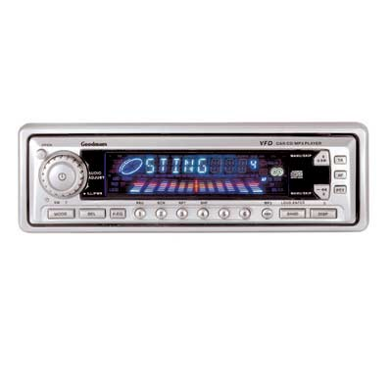

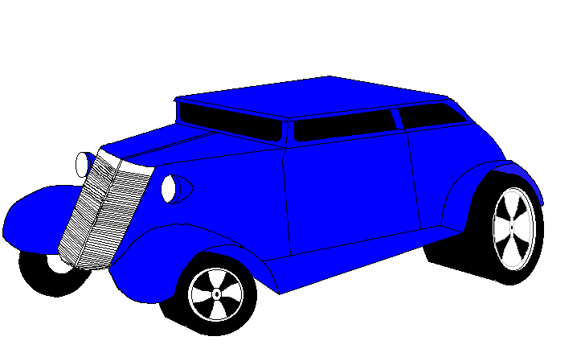

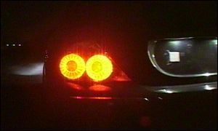
Energy Transfer
Mechanical (sound)
Electromagnetic (light)
Electrical
Thermal
Mechanical
Electrical
Chemical
Electrical
Electromagnetic
(light)
Notes:
Instructional Approach(s): The teacher should use the images on the slide to illustrate the energy transformation in a car after allowing students to discuss them on the previous slide.

Slide 12
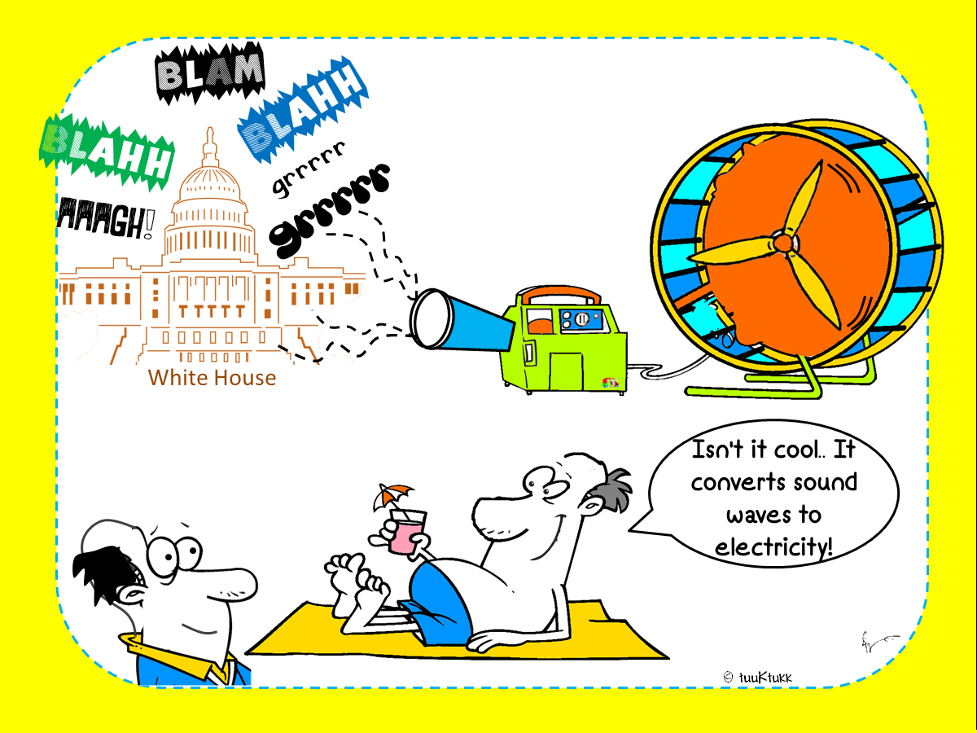
Notes:
Instructional Approach(s): The teacher should use the images on the slide to illustrate the energy transformations.

Slide 13
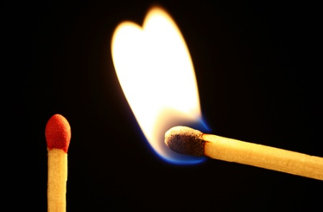
Identify the energy transformations that occur when lighting a match.
Lighting a match video clip (click on the picture below)
In the video, chemical energy in the match changes to thermal (heat) energy and electromagnetic (light) energy.
While the match is burning, is the amount of chemical energy in the match the same? Why or Why not?
As the match is burning, the chemical energy is decreasing while the thermal energy and the radiant energy are increasing.
Notes:
Instructional Approach(s): The teacher should present the link. The teacher should ask the class or call on students to answer the question. Click the mouse to reveal the answer.

Slide 14
Study Jams Video:
Energy and Matter
http://studyjams.scholastic.com/studyjams/jams/science/matter/energy-and-matter.htm
Notes:
Instructional Approach(s): The teacher should show the video to reinforce the concepts of energy and matter

Slide 15
Let’s see what you know about energy transformations.
The following slides will show an image. Guess the type of energy transformation that occurs in the image.
Notes:
Instructional Approach(s): The teacher should present the information on the slide. Students can work individually or with a partner. However, the teacher should use the activity as a form of formative assessment to determine if students are mastering the concepts of energy transformations.

Slide 16

Identify the Energy
Transformation
Electrical ⇨ Mechanical (Sound)
Notes:
Instructional Approach(s): The teacher should present the animated slide. The teacher should ask the class or call on students to answer the question. Click the mouse to reveal the answer.

Slide 17


Identify the Energy
Transformation
Nuclear Electromagnetic (Light) and Thermal ⇨Chemical
Notes:
Instructional Approach(s): The teacher should present the animated slide. The teacher should ask the class or call on students to answer the question. Click the mouse to reveal the answer.

Slide 18

Identify the Energy
Transformation
Chemical ⇨Mechanical
Thermal
Notes:
Instructional Approach(s): The teacher should present the animated slide. The teacher should ask the class or call on students to answer the question. Click the mouse to reveal the answer.

Slide 19

Identify the Energy
Transformation
Electrical ⇨ Thermal (Heat)
Notes:
Instructional Approach(s): The teacher should present the animated slide. The teacher should ask the class or call on students to answer the question. Click the mouse to reveal the answer.

Slide 20

Identify the Energy
Transformation
Chemical ⇨Mechanical Thermal

Slide 21
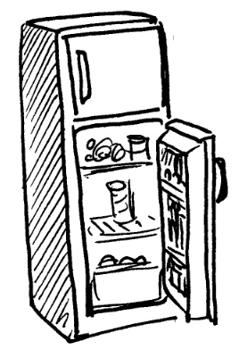
Identify the Energy
Transformation
Electrical ⇨Mechanical and Thermal (Heat)
Notes:
Instructional Approach(s): The teacher should present the animated slide. The teacher should ask the class or call on students to answer the question. Click the mouse to reveal the answer.

Slide 22

Identify the Energy
Transformation
Mechanical ⇨Thermal (Heat)
Notes:
Instructional Approach(s): The teacher should present the animated slide. The teacher should ask the class or call on students to answer the question. Click the mouse to reveal the answer.

Slide 23

Identify the Energy
Transformation
Electrical ⇨Electromagnetic and Thermal
Notes:
Instructional Approach(s): The teacher should present the animated slide. The teacher should ask the class or call on students to answer the question. Click the mouse to reveal the answer.

Slide 24

Identify the Energy
Transformation
Chemical ⇨Electromagnetic and Thermal
Notes:
Instructional Approach(s): The teacher should present the animated slide. The teacher should ask the class or call on students to answer the question. Click the mouse to reveal the answer.

Slide 25

Identify the Energy
Transformation
Electromagnetic ⇨Electrical and Thermal
Notes:
Instructional Approach(s): The teacher should present the animated slide. The teacher should ask the class or call on students to answer the question. Click the mouse to reveal the answer.

Slide 26

Identify the Energy
Transformation
Mechanical (Sound) ⇨Electrical ⇨ Mechanical (Sound)
Notes:
Instructional Approach(s): The teacher should present the animated slide. The teacher should ask the class or call on students to answer the question. Click the mouse to reveal the answer.

Slide 27
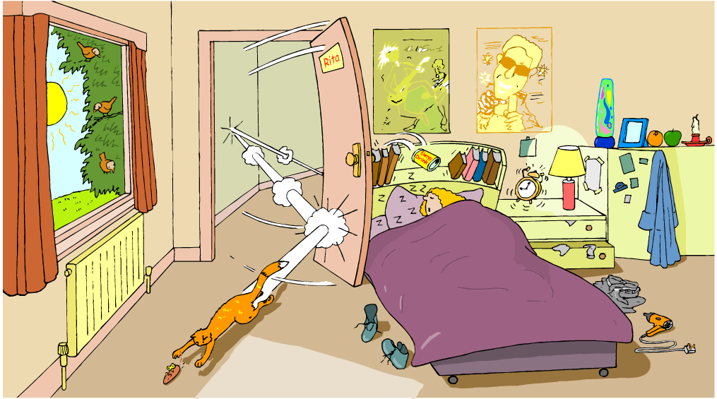
Identify energy transformations in the illustration below. Include the following: Thermal, Electromagnetic, Mechanical, Electrical, & Chemical
Notes:
Instructional Approach(s): Each student should complete the summarizer. The teacher should use the summarizer to determine the level of student mastery and if differentiation is needed.

